Slide 1
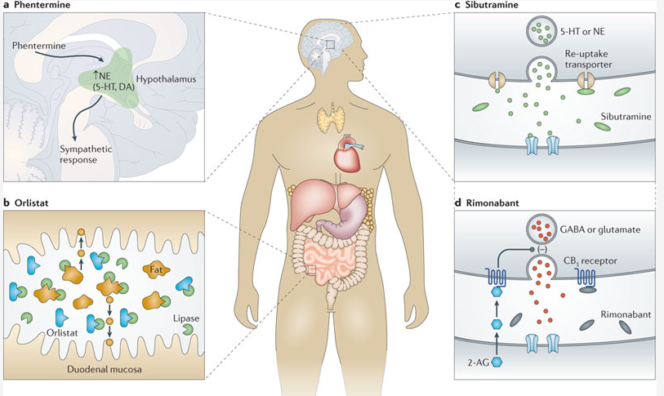
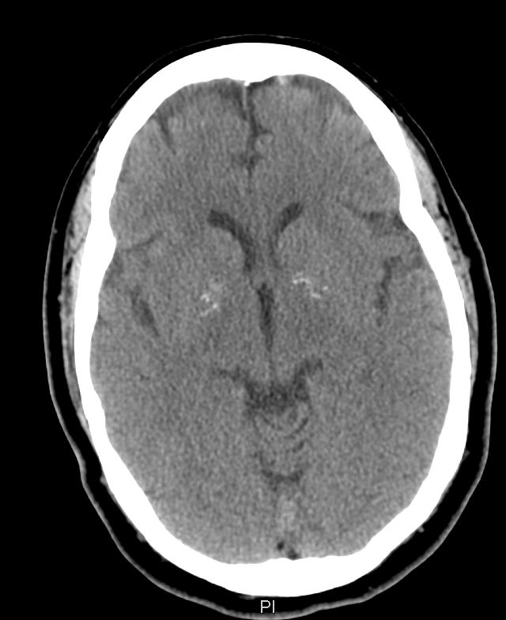
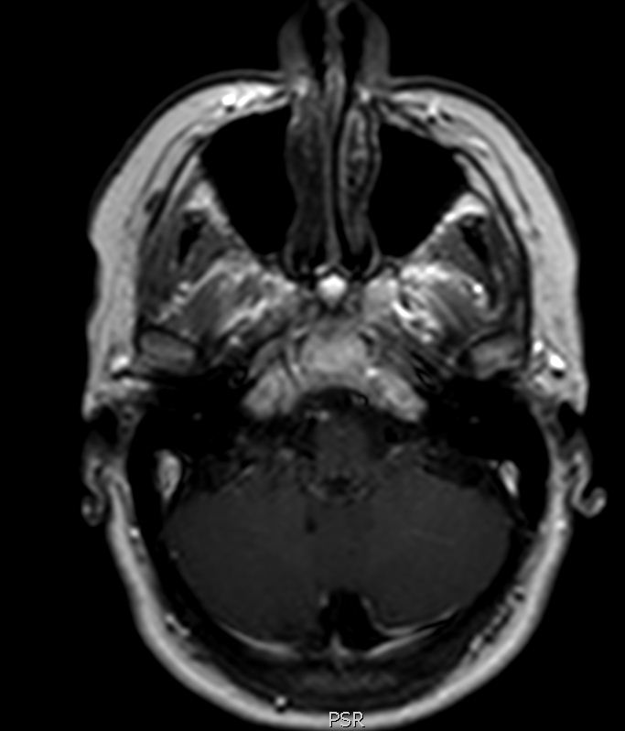
PHENTERMINE INDUCED SEIZURE
MOHAMED BARAKAT M.D., MOSTAFA ALFISHAWY M.D., OLUWASEUN AKINSEYE M.D., SUSAN SANELLI-RUSSO M.D.
Introduction
Discussion
New onset seizures in older adults often warrants further investigation. Drug induced seizures are common due to the growing number of medications required by older patients. Medication can be epileptogenic or may lead to a decrease in the seizure threshold and the seizure risk in a previously healthy individual increases when those agents are administered concomitantly.
Phentermine is a sympathomimetic amine that acts as a central nervous system stimulant. It has similar pharmacologic activity similar to the prototype anorectic drug amphetamine. The exact mechanism of weight loss is unknown (likely increasing noradrenaline in CNS Fig 1) however it is FDA approved for short term use as an adjunct therapy. Frequently reported adverse effects, of phentermine include anxiety, mouth dryness, irritability and insomnia. Review of the literature revealed controversial data about the safety of phentermine when added to fenfluramine with regards to seizure activity[1]. Fenfluramine alone has been reported as successful add-on treatment to control resistant seizures in Dravet syndrome [2]. Further review revealed that the safety of phentermine was based on two trials [3,4] with a total of 179 participants ages 19-53. There were no reported seizures in the patients that received phentermine. Pubmed and MedWatch were searched for reported incidents on phentermine induced seizures but no reported cases were found.
Phentermine is the most common prescribed medication for obesity yet data regarding its safety profile is lacking. It is essential to explore phentermine's safety and drug-drug interactions in light of its possible implication in serious central nervous adverse effects leading to seizures or epilepsy especially in the older population.
Case Report
61 year old woman with known depression, hypertension and obesity was admitted with a new onset witnessed generalized tonic clonic seizure lasting 2-3 minutes and aborted spontaneously. Her seizure was preceded by nausea and a sensation of light headedness. She remained in an altered mental status for 2 hours, after regaining consciousness she had no recollection of the episode. She had a non-contrast CT of the brain showing faint basal ganglia calcification (Fig 2), MRI of the brain showed cisterna magna and partial empty sella (Fig 3), EEG was normal. Her basic metabolic profile and complete blood count were all within normal limits. History revealed that she had been receiving amphetamine for the past 20 years for her obesity and that it had been discontinued 3 weeks prior to presentation and phentermine had been initiated in its place. 6 month follow up with the patient did not reveal any additional seizures after discontinuing phentermine.
Fig 1 Mechanism of action of weight loss medications
Conclusion
Fig 2 CT showing faint Basal Ganglia calcification Fig 3 MRI showing Cisterna Magna
References
1 Spencer DC, Hwang J, Morrell MJ. Fenfluramine-Phentermine (Fen-Phen) and Seizures: Evidence for an Association. Epilepsy Behav. 2000 Dec;1(6):448-452.
2 Ceulemans B, Boel M, Leyssens K, Van Rossem C, Neels P, Jorens PG, Lagae L. Successful use of fenfluramine as an add-on treatment for Dravet syndrome. Epilepsia. 2012 Jul;53(7):1131-9. doi: 10.1111/j.1528-1167.2012.03495.x. Epub 2012 May 3.
3 Langlois KJ, Forbes JA, Bell GW, Grant GF Jr. A double-blind clinical evaluation of the safety and efficacy of phentermine hydrochloride (Fastin) in the treatment of exogenous obesity. Curr Ther Res Clin Exp. 1974 Apr;16(4):289-96.
4 Cohen A, De Felice EA, Leb SM, Fuentes JG, Rothwell KG, Truant AP. Double-blind comparison of efficacy, safety, and side effects of Bionamin, phentermine compound, and placebo in the treatment of exogenous obesity. Curr Ther Res Clin Exp. 1968 Jul;10(7):323-34.

