Slide 1
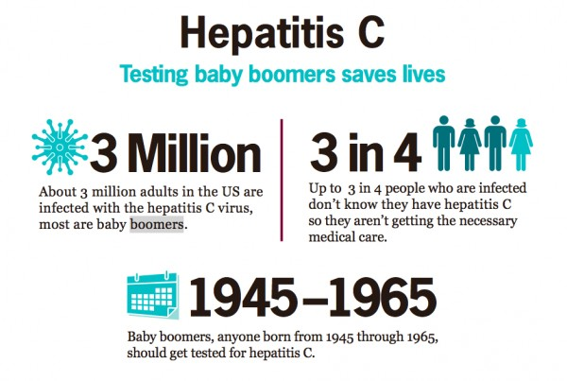
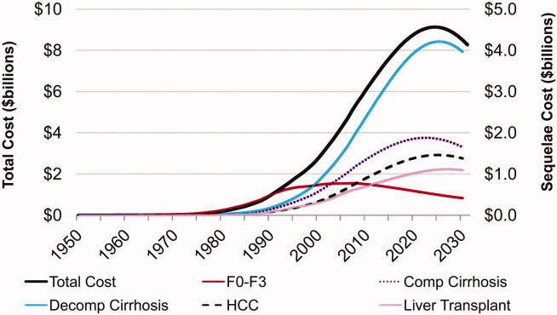
Impact of Hepatitis C Screening in Outpatient Population Madhuri Chandnani MD, Pallavi Pothuri MD, Michael Stevens MD, Nina Kello MD, Vincent Rizzo MD, MBA, FACP NYC Health + Hospital/Queens – Icahn School of Medicine at Mount Sinai, New York.
Introduction
47% were Asians, with Black (41%) as the next majority. Approximately 26% patients were from United States of America and Guyana each. Only 244 patients were screened during the eighteen months prior to the law, resulting in one false positive HCV antibody test.
For patients born between 1945 and 1965 with no identifiable risk factors, one-time Hepatitis C (HCV) screening test was recommended by CDC and USPSTF in 2012 and 2013 respectively ^{[1,2]}. In January 2014, the state of New York mandated the offer of HCV screening for this cohort. ^{[3]}
Discussion
Objectives
According to the Center for Disease Control and Prevention (CDC), approximately 2.7 – 3.5 million people in the United States have chronic HCV infection and approximately three fourths of this population is accounted by baby boomers born between 1945 and 1965 ^{[5]}. Many of these people are unaware about being infected with HCV. HCV infection contributed to the deaths of nearly 20,000 Americans in 2013. ^{[6]} Our study demonstrates the cost effectiveness of the NYS law of mandatory HCV testing in a city hospital setting, in accordance to the US national data ^{[7]}.
We performed a retrospective study investigating the benefits of cohort-based HCV screening in terms of identification of asymptomatic HCV infection and its treatment in a city hospital setting.
Methods
 | QHC Cost
Single HCV antibody test | $ 74
Total spent on screening 3206 patients | $237,244
Cost per diagnosis (excluding treatment) | $39,541
Patients born between 1945 and 1965 and screened for HCV in the ambulatory care setting at Queens Hospital Center (QHC) were divided into 2 groups. The first group consisted of patients screened between 7/2012 - 12/2013 and the second between 1/2014 - 7/2015 after the NY law was passed. Patients with high risk factors including deranged liver function test were excluded from the study.
References
(1) Smith et al. Hepatitis C Virus Testing of Persons Born During 1945–1965: Recommendations from the Centers for Disease Control and Prevention. Ann Intern Med. 2012; 157(11):817-822.
(2) Moyer VA. U.S. Preventive Services Task Force. Screening for hepatitis C virus infection in adults: U.S. Preventive Services Task Force recommendation statement. Ann Intern Med. 2013; 159(5):349-357.
(3) New York State Department of Health. Available at ‘http: //www.op.nysed.gov/news/DearColleagueHCVTest_SignedLetter.pdf’. Accessed on March 1, 2016.
(4) El-Khoury A., Vietri J., Prajapati G. The Burden of Untreated Hepatitis C virus infection: A US Patients’ Perspective. Dig Dis Sci 2012; 57:2995-3003.
(5) Centers for Disease Control and Prevention. Recommendations for the identification of chronic hepatitis C virus infection among persons born during 1945–1965. MMWR. 2012; 61(RR-04):1-18.
(6) Centers for Disease Control and Prevention. “Viral Hepatitis Statistics and Surveillance.” http://www.cdc.gov/hepatitis/Statistics/ Accessed on March 1, 2016.
(7) Rein et al. The cost-effectiveness of birth-cohort screening for hepatitis C antibody in U.S. primary care settings. Ann Intern Med. 2012; 156(4):263-70.
(8) Razavi et al. Chronic Hepatitis C Virus (HCV) Disease Burden and Cost in the United States. Hepatology. 2013 Jun; 57(6): 2164–2170.
Results
After January 2014, a total of 3206 patients were screened and approximately 1% (n=34) of patients had reactive HCV antibody test. Six patients were successfully treated and cured of HCV, resulted as non-detectable HCV load after treatment. At least $39,541 was spent per diagnosis, which along with the average treatment cost, is much lower than the average cost of an untreated HCV infection with chronic liver disease and related complications ^{[4]}. Among the 34 patients found to have positive HCV antibody, approximately 62% were women.
Projected HCV sequelae cost: US 1950-2030 ^{[8]}
Seventh Annual Research Day – Icahn School of Medicine at Mount Sinai

