Slide 1

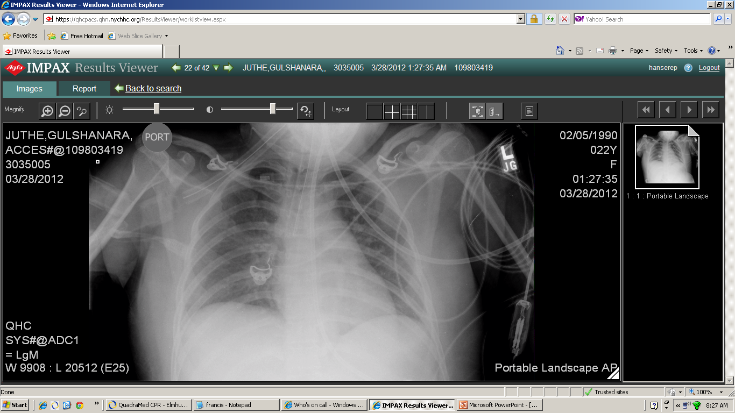
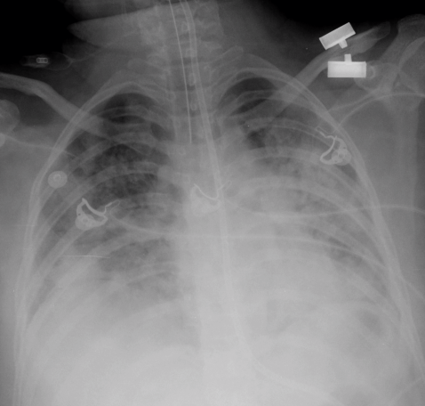
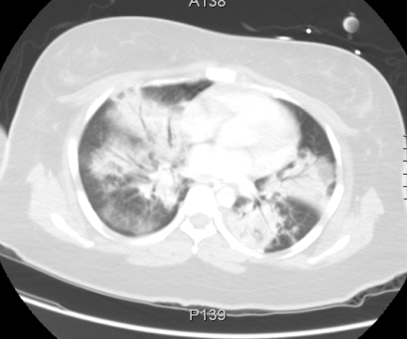
An atypical presentation of Neuroleptic Malignant Syndrome coexisting with Staphylococcus Pneumonia: a diagnostic challenge
Preaw Hanseree MD, Joanna M. Tulczynska MD
Department of Medicine, Queens Hospital Center, Mount Sinai School of Medicine, New York
Introduction
Figure 1. Temperature trend after starting treatment for NMS
Discussion
ºC
NMS is rare but potentially life-threatening condition. Sometimes NMS is difficult to identify in the presence of critical illnesses because they can obscure the manifestation of NMS. Furthermore, pneumonia is the most common complication found in 13% of patients with NMS, likely due to altered mental status combined with difficulty swallowing that lead to aspiration. As in our case, the patient presented with altered mental status, fever, and hypotension which could be simply explained by the presence of pneumonia and sepsis. However, due to lack of clinical response after appropriate antibiotic treatment, the other coexisting condition was suspected.
It is important to have high index of suspicious for NMS in the setting antipsychotic therapy. The absence of muscle rigidity should not exclude a diagnosis of NMS. Elevated CK level helps support the diagnosis of NMS in patients with atypical presentation. An early diagnosis is crucial. If not recognized or left untreated, it may be fatal.
Neuroleptic malignant syndrome (NMS) is a life-threatening neurologic disorder associated with the use of neuroleptic agents. NMS typically characterized by clinical syndrome of mental status change, muscle rigidity, fever, and autonomic instability. Atypical cases may present without muscle rigidity and/or hyperthermia. Association of infection in atypical case can make the diagnosis challenging.
Day
Treatment started
Case Presentation
Figure 2. CK trend after starting treatment for NMS
A 22-year-old female with a history of schizophrenia and seizure disorder was found unarousable by her mother. She had multiple suicidal attempts in the past and took medications include haloperidol, olanzapine, trazodone, clonazepam, benztropine, and trihexyphenadyl without supervision. On presentation, the patient was drowsy, hypotensive, tachycardic, and was intubated for airway protection. Initial drug screen was negative for substances of abuse. Overdose with multiple medications was suspected and supportive care was provided. On the second day the patient developed fever of 38.9ºC. Chest x-ray and CT showed bilateral infiltrations, so empiric piperacillin/tazobactam and vancomycin were started for aspiration pneumonia. Sputum culture grown methicillin-resistant, vancomycin-sensitive Staphylococcus aureus. However, the patient remained febrile, temperature of 39.6ºC, despite appropriate antibiotic treatment. Serum creatine kinase (CK) rose from 106 U/L on admission to 8,105 U/L. We considered the diagnosis of NMS based on alteration of mental status, hyperthermia, autonomic instability, and elevated CK level, with the use of neuroleptic agents, although the patient did not have muscle rigidity. The patient was started on dantrolene in addition to intravenous fluid and antibiotics. Shortly afterwards temperature and CK level started to trend down. Her mental status was gradually improved. She became afebrile on day 10 of dantrolene treatment and serum CK returned to normal level after 2 weeks.
U/L
Conclusion
Day
Treatment started
On admission
Day 2

