Slide 1
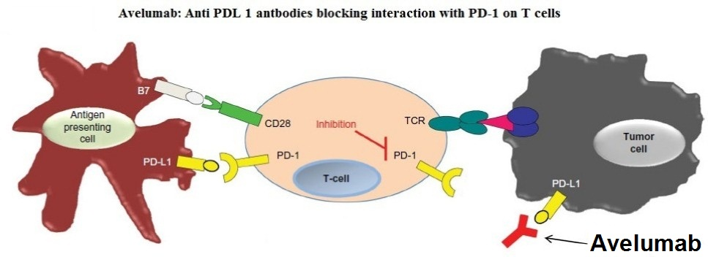
Avelumab Inducing both Hypothyroidism and Hypoadrenalism in a Recurrent Gastric Cancer Patient: A Case Report
Viki Kumar MD, Jaspinder Kaur MBBS, Paul Kim MD FACE, Issac Sachmechi MD FACE FACP
Department of Medicine, Icahn School of Medicine at Mount Sinai
Introduction
 | TSH (0.35-3.5) | FT4 (0.58-1.64) | Cortisol (0.7-22.4) | Avelumab
Oct 2014 | 1.37 | 1.03 | - | No
Jan 2015 | 0.01 | 1.75 | - | Yes
May2015 | 24.06 | 0.63 | 0.4 | Yes
Dec 2015 | 10.02 | 1.34 | - | DC
Discussion cont.
Avelumab (MSB0010718C) is an investigational fully human IgG1 monoclonal antibody that binds to the programmed death-ligand 1 (PD-L1) protein and competitively block interaction with programmed death-1 (PD-1) receptors thereby enables the activation of T-cells and the adaptive immune system (image) [1].
Our patient developed hyperthyroidism initially and then later hypothyroidism and hypoadrenalism on avelumab. However, the exact mechanism and frequency of these autoimmune conditions resulting from therapeutic blockade of these receptors is not yet known. One of the possibility can be continuing interaction between PD-1 and PD-L1 to prevent T cell receptor (TCR) driven signals to maintain self tolerance, which upon anti-PD-L1 blockade could activate autoreactive T cells resulting in the autoimmune conditions [5]. Secondly, avelumab, unlike other PD-L1 targeting agents, by retaining a native Fc-region binds to Fc receptors expressed by cytotoxic cells and could induce antibody-dependent cell-mediated cytotoxicity (ADCC) [1].
Case Presentation
70 year old male with past medical history of type 2 diabetes mellitus and stage 4 gastric cancer s/p Billroth 2 subtotal gastrectomy presented with recurrent gastric cancer and pancreatic mass. He was started on clinical trial drug “avelumab” after showing intolerance to six cycles of docetaxel, cisplatin and 5-fluorouracil.
After receiving eight cycles of avelumab, patient was diagnosed with subclinical hyperthyroidism having TSH of 0.01ng/dl (0.35-3.5) and FT4 of 1.49ng/dl (0.58-1.64). He showed good response to tapazole 5mg every other day for resting tachycardia. After completion of fifteen cycles, he was complaining of fatigue, nausea, vomiting, and found to be hypotensive with serum sodium of 125 mg/dl (136-146). His other lab revealed serum cortisol of <0.4 (0.7-22.4), TSH 24.06ng/dl, and FT4 of 0.63ng/dl. He was admitted with hypothyroidism and hypoadrenalism; and started on hydrocortisone 20mg in AM and 10mg in PM; and oral sodium chloride tablets. Tapazole was stopped initially and later on started with levothyroxine 50mcg which was titrated up to 88mcg. Avelumab was restarted provided patient was feeling better and his lab was normalized.
*DC: Discontinue
Discussion
PD-1 is one of an immune checkpoint receptor that prevents overstimulation of immune responses and contributes to the maintenance of immune tolerance to self-antigens [2]. It is expressed on chronically stimulated T cells, activated B cells, and NK cells, thus regulates immunity at multiple phases of the immune response. The activity of PD-1 is related to its interaction with its ligands, PD-L1 and PD-L2. However, both ligands, especially PD-L1, are expressed on many hematologic and solid tumors including gastric cancer [3]. Hence, when PD-1 binds with cells bearing PDL-1, T cell activity is attenuated which prevents these T cells from rejecting the tumor at the tissue level, and thereby tumors can employ the PD-1 inhibitory pathway to silence the immune system [4].
Conclusions
Patients treated with avelumab warrant close clinical monitoring as well as monitoring of serum cortisol and thyroid function tests due to its predisposition to cause autoimmune disorder of thyroid and adrenal glands.
References
1.C. Heery, G. H. Coyne, R. A. Madan et al.. 2014. “Phase I open-label, multiple ascending dose trial of MSB0010718C, an anti-PD-L1 monoclonal antibody, in advanced solid malignancies,” Journal of Clinical Oncology, vol. 32, abstract 3064.
2. O.kazaki T, Honjo T. 2007. PD-1 and PD-1 ligands: from discovery to clinical application. Int Immunol 19: 813–824.
3. D.B. Page, M. A. Postow, M. K. Callahan, J. P. Allison, and J. D. Wolchok. 2014. “Immune modulation in cancer with antibodies,” Annual Review of Medicine, 65:185–202.
4. A. Pedoeem, I. Azoulay-Alfaguter, M. Strazza, G. J. Silverman, and A.Mor. 2014. “Programmed death-1 pathway in cancer and autoimmunity,” Clinical Immunology, 153:145–152.
5. Fife B.T., Pauken K.E., Eagar T.N., Obu T, Wu J, Tang Q, etal. 2009. Interactions between PD-1 and PD-L1 promote tolerance by blocking the TCR- induced stop signal. Nat Immunol 10:1185–92.

