Slide 1
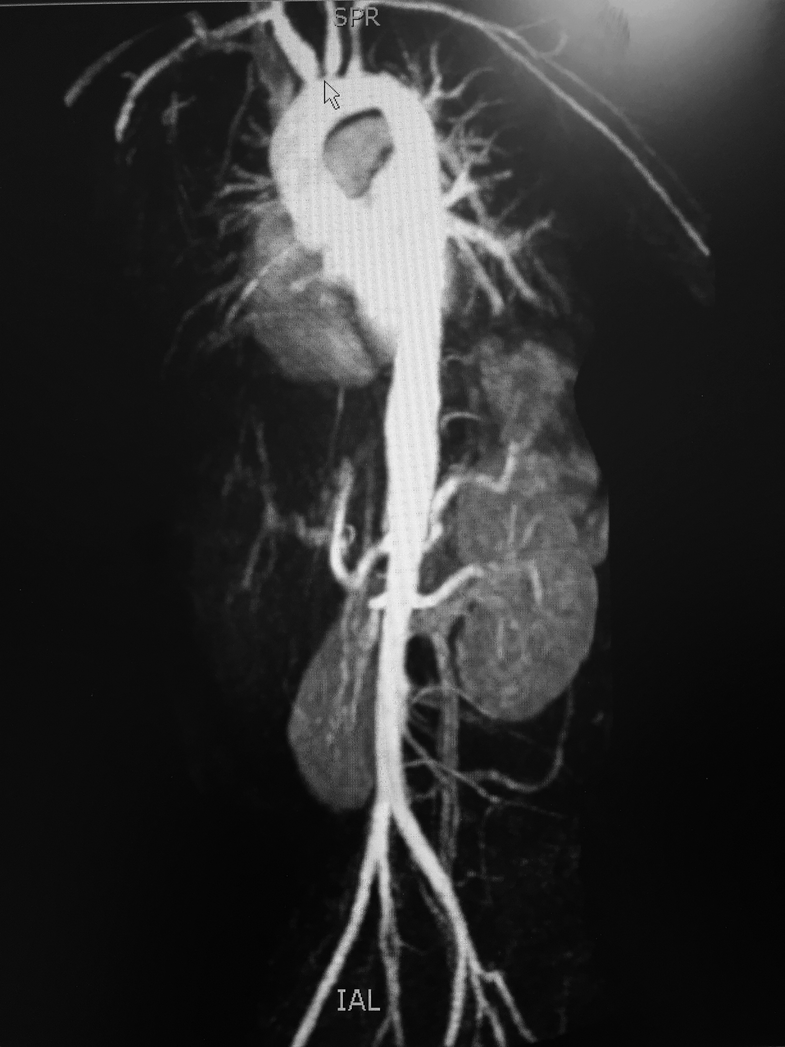
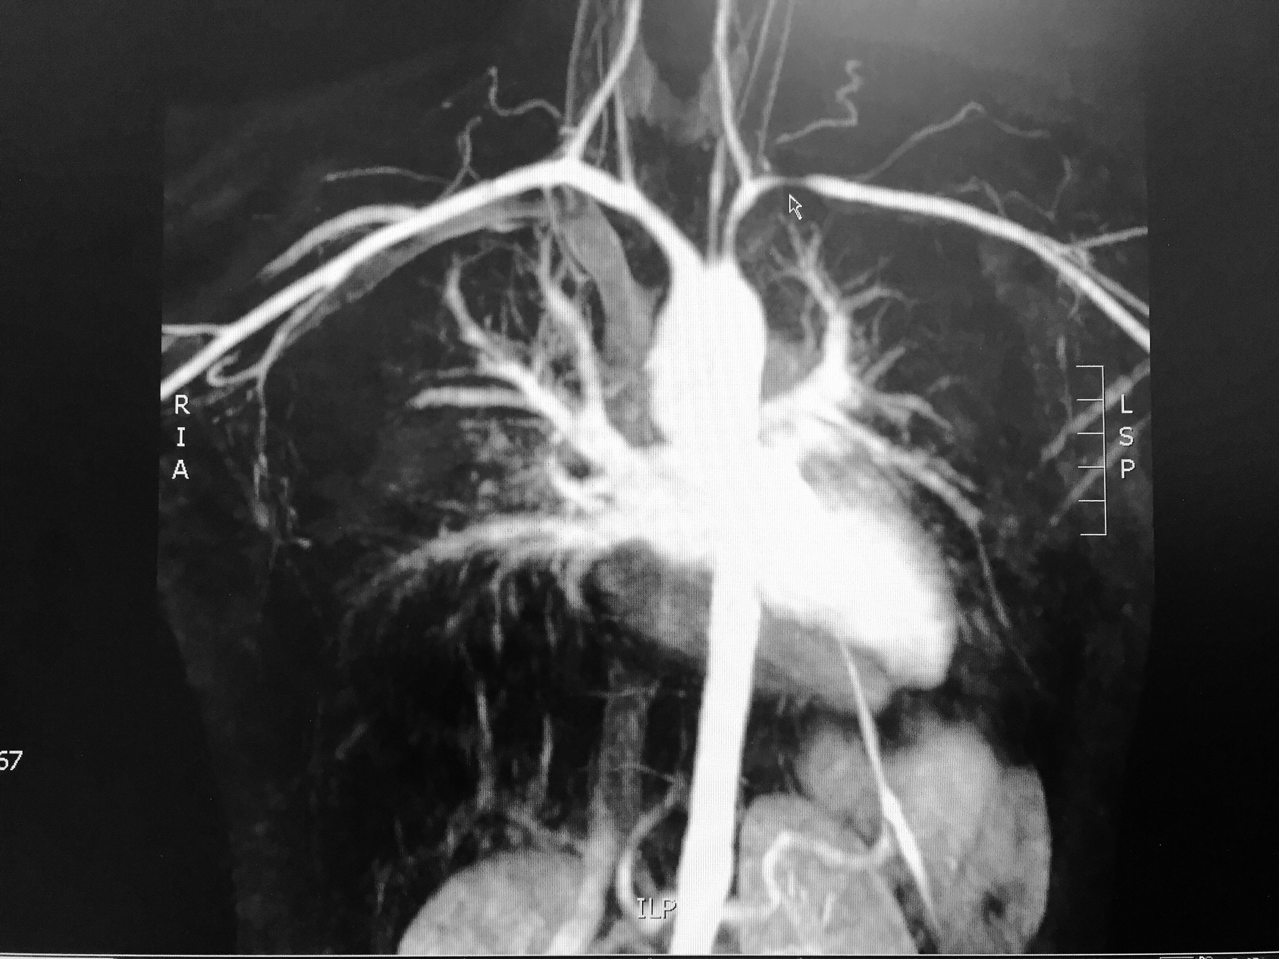
Takayasu Arteritis Presenting as Abdominal pain - An Unusual Case Rudra Paudel, MD; Luis Chavez, MD; Ravi Kumar Metai, MD; Adriana Abrudescu, MD Department of Medicine, NYC Health + Hospital/Queens
Discussion:
Takayasu arteritis is rare form of large vessel vasculitis that predominantly affects young female. In Asian and South-American descent, cervical and thoracic arterial lesions are more prevalent unlike in our case where there was involvement of abdominal arteries.
Constitutional symptoms like fever, weight loss, fatigue , malaise seems to be more common as initial presentation of the condition, however symptoms related vascular insufficiency like limb claudication and abdominal pain, like in our case can also be the only complain.
Diagnosis of Takayasu arteritis can be made on clinical findings alone like limb claudication, decreased brachial artery pulse, difference in blood pressure>10, presence of bruits over subclavian arteries or aorta and age<40. Arteriogram suggesting involvement of large blood vessels is supportive as well. Even though our case had all the clinical findings, due to non specific nature of symptoms, our case was likely overlooked on initial presentations.
Conclusion:
We conclude by emphasizing the importance of considering vasculitis like Takayasu arteritis as a differential diagnoses in a young patient presenting with abdominal pain and non specific symptom like fatigue. We would also like to highlight the importance of comprehensive history and meticulous physical examination including that of vascular system for diagnosis of this rare condition and further timely management and prevention of complications.
Introduction:
Takayasu arteritis is a rare form of vasculitis which affects the large blood vessels and can present as constitutional symptoms like pain, fatigue, weight loss and low grade fever. Diagnosis, most of the time can be made just on clinical grounds rather than imaging/histology. However, many of the times diagnosis is easily missed because of lack of high clinical suspicion and thorough physical examination. We present a case of young female of South-American descent presenting as abdominal pain.
Case Report:
A 20 y/o F with PMH of H. Pylori, and Iron deficiency anemia presented to ED with complaint of progressive abdominal pain for one month, located on mid-abdomen, pulsating in nature, non-radiating, aggravated by exertion and relieved to some extent by rest and associated with nausea but no vomiting. She had multiple ED visits over last one year for similar pain, on all occasions her pain subsided after receiving pain medicines in the emergency and was discharged with impression of of likely musculoskeletal causes. Examination was significant for impalpable left radial pulse and unmeasurable BP in left arm. Bruit was auscultated in the bilateral carotid and lower mid abdomen.
ESR was 145 mm/hr and CRP was 13 mmol/L. The CBC, BMP, PT, PTT and rheumatologic workups were all unremarkable. TEE was normal.
Chest/abdomen/Neck angiogram revealed diffuse non specific thoracic aortic wall thickening measuring up-to 4mm in thickness with thickening involving origin of the great vessels (Image1), severe stenosis of left subclavian artery (Image 2), alternating luminal narrowing and dilatation in descending thoracic aorta and involvement of proximal superior mesenteric artery.
She was treated with intravenous 1gm methyl-prednisolone for 3 days and started on Prednisone 30 mg twice daily. Methotrexate was added to her regimen. One month later, her ESR went down to 48 mm per hour and CRP was 1.57. Her abdominal pain was completely resolved.
References:
1. Takayasu arteritis revisited: current diagnosis and treatment. Isobe M¹.
2. The American College of Rheumatology 1990 criteria for the classification of Takayasu arteritis. Arend WP¹, Michel BA, Bloch DA, Hunder GG, Calabrese LH, Edworthy SM, Fauci AS, Leavitt RY, Lie JT, Lightfoot RW Jr,
3. The relationship between abdominal pain regions and specific diseases: an epidemiologic approach to clinical practice. Yamamoto W¹, Kono H, Maekawa M, Fukui T
4.Association of vascular physical examination findings and arteriographic lesions in large vessel vasculitis.Grayson PC¹, Tomasson G, Cuthbertson D, Carette S, Hoffman GS, Khalidi NA, Langford CA, McAlear CA, Monach PA, Seo P, Warrington KJ, Ytterberg SR,Merkel PA; Vasculitis Clinical Research Consortium

