Slide 1
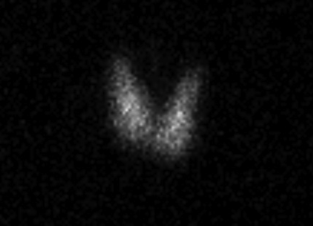
Recurrent Silent Thyroiditis as a Sequela of Postpartum Thyroiditis
Preaw Hanseree, MD, Vincent Salvador, MD, Issac Sachmechi, MD, FACE, Paul Kim, MD, FACE Department of Medicine, Icahn School of Medicine at Mount Sinai,Queens Hospital Center
Introduction
Date | Free T4 (0.58-1.64 ng/dL) | T3 (87-178 ng/dL) | TSH (0.35-3.5 mIU/mL) | 24-h RAIU (15-40%) | Diagnosis
November 2010 (1 month postpartum) | 0.76 | 157 | 1.05 | 27.4% | Euthyroid
March 2011 (5 months postpartum) | 2.09 | 212.6 | 0.00 | 0.6% | Postpartum Thyroiditis
December 2011 |  |  | 2.98 |  | Euthyroid
May 2012 (19 months postpartum) | 3.10 | 269.8 | 0.02 |  | 1st Recurrent Thyroiditis
November 2012 | 0.93 |  | 2.97 |  | Euthyroid
February 2013 | 0.78 | 70.28 | 4.79 |  | Hypothyroid
July 2013 (33 months postpartum) | 3.11 |  | 0.01 | 0.8% | 2nd Recurrent Thyroiditis
September 2013 | 0.60 |  | 0.81 |  | Euthyroid
Discussion
Thyroiditis encompasses a group of disorders characterized by thyroid inflammation. Though clinically indistinguishable from silent thyroiditis, postpartum thyroiditis occurs in women within 12 months after delivery. Recurrent postpartum thyroiditis in subsequent pregnancies is common, but recurrent silent thyroiditis is rare. We reported a case of patient with recurrent episodes of thyroiditis, unrelated to pregnancy, after an episode of postpartum thyroiditis.
The prevalence of postpartum thyroiditis varies widely from 1.1 to 21.1%. Risk factors that may predispose the development of postpartum thyroiditis are the presence of thyroid peroxidase antibodies, past history of thyroid disease, family history of thyroid disease, and type 1 diabetes mellitus. After a first episode of postpartum thyroiditis, there is a 70% chance of recurrence with subsequent pregnancies in women with positive thyroid peroxidase antibodies. Even though the clinical features of silent thyroiditis are similar to postpartum thyroiditis, the recurrence rate is less than 10%. The largest number of recurrences noted in a single patient is nine. Yamamoto et al. reported a patient with 7 episodes of silent thyroiditis within 4 year period, between 2 episodes of postpartum thyroiditis. We reported the second case of recurrent silent thyroiditis following postpartum thyroiditis.
Table 1. Temporal profile of thyroid function test and thyroid uptake scan
Case Report
A 31-year-old pregnant woman visited the Thyroid clinic for routine follow up of previously diagnosed hyperthyroidism. She remained clinically and biochemically euthyroid during the pregnancy while on methimazole which was discontinued postpartum. Five months after, she was diagnosed with postpartum thyroiditis manifesting with palpitations and tremors. Neck exam was essentially normal. Thyroid panel revealed severely suppressed TSH (0 mIU/mL), elevated free T4 (2.09 ng/dL) and T3 (212.6 ng/dL) twice from their baseline upper normal limits. Scintigraphic thyroid imaging was notable for decreased thyroid uptake (0.6%). Antibodies to thyroglobulin were positive. In two months she became euthyroid which persisted for the next eleven months until she developed the first episode of recurrent thyroiditis. The second episode occurred fourteen months after the previous one. She became euthyroid in the next 2 months. She was offered thyroidectomy or radioablative iodine treatment to which the patient declined at the present. She remains clinically and biochemically euthyroid at this time.
Figure 1. Thyroid scan performed a year prior to presentation of thyroiditis showing normal
thyroid gland uptake.
Conclusion
Postpartum thyroiditis and silent thyroiditis are normally self-limited. Definitive treatment such as radioablative iodine therapy or thyroidectomy may be considered in some cases of recurrent thyroiditis.
Figure 2. Thyroid scan during the thyroiditis flare showing no significant tracer uptake. Thyroid gland could not be visualized.

