Slide 1
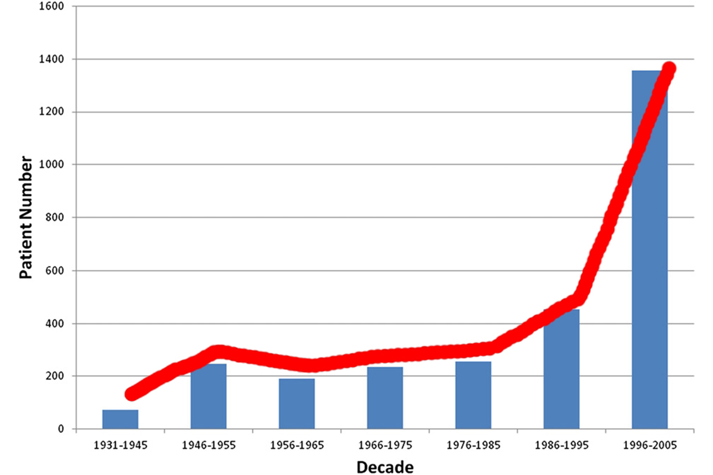
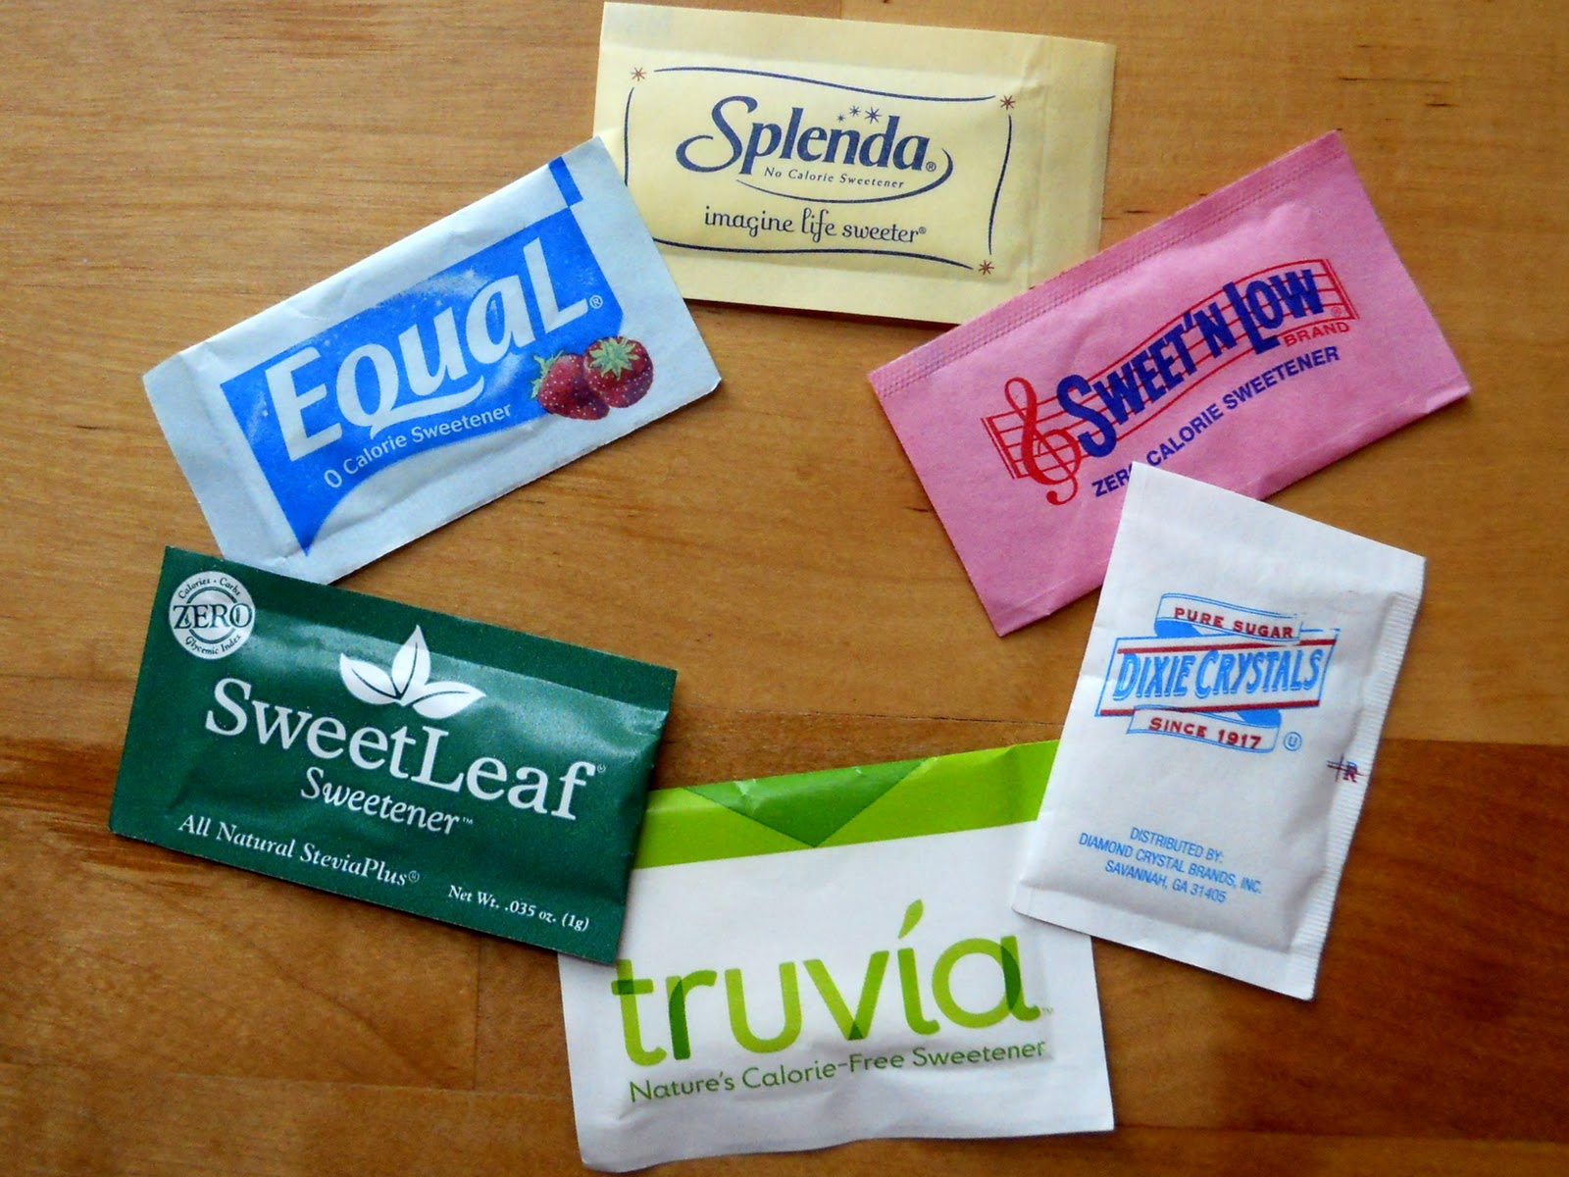
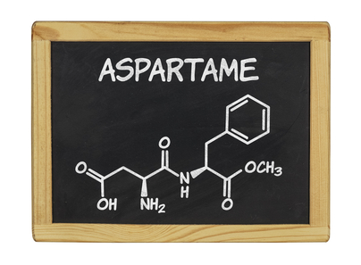
A Retrospective Medical Record Review and Telephonic Survey to Assess the Association between
Artificial Sweeteners (AS)and Well Differentiated Thyroid Cancer (WDTC)
Sandeep Singh MD, Abdullah Mahmood MD, Pallavi Pothuri MD, Issac Sachmechi MD, FACP,FACE Department Of Medicine/ Endocrine Icahn School of Medicine at Mount Sinai/ Queens Hospital Center Jamaica, NY
Introduction
Material and Methods
Discussion
Conclusions
Consumption of artificial sweeteners (AS) has increased in the USA and Europe over the past three decades. Critics of AS say that they cause a variety of health problems, including cancer. Studies have linked saccharin and cyclamates to bladder cancer in laboratory rats [1]. In 2005, a laboratory study found more lymphomas and leukemia in rats fed with very high doses of aspartame [2]. However, no definitive studies are available in human beings. The National Cancer Institute's Surveillance Epidemiology and End Results (SEER) has reported an increase in incidence of WDTC [3]. The cause of this increase is not known.
A retrospective study that included 50 patients with age 18 years and above who have been diagnosed with WDTC between Jan 1, 2004 – Aug 31, 2014 at Queens Hospital Center and Elmhurst Hospital Center was performed. A telephonic survey of 15min duration was conducted after appropriate consent was obtained. The survey questionnaire was pertaining to the use of AS in their diet. Based on the data collected, the average number of AS packets consumed per user was calculated. A statistical analysis using proportionate testing was conducted.
AS have been reported to cause various cancers in animal studies but we lack such studies in humans. Aspartame, Sucralose and Saccharin, the main ingredients of artificial sweeteners are known to cause cancers in animals. A previous report suggested that AS can be associated with Hashimoto’s thyroiditis [4]. It has been found in different studies that heavy AS (>1680mg/day) use leads to an increased relative risk of 1.3 for bladder cancer in humans [5].
This study emphasizes the significance of AS consumption as a potential risk factor for WDTC and increase public awareness for it.
Graph: Nixon IJ, Ganly I, Patel SG, Palmer FL, Whitcher MM, Ghossein R, Michael Tuttle R, Shaha AR, Shah JP. ‘Changing trends in well differentiated thyroid carcinoma over eight decades’ . Int J Surg.;10(10); 618-23.
.
Results
Based on the cumulative data, it was found that 38 out of 50 patients (76%) took sugar substitutes while 12 patients (24%) did not take any such products. The average number of packets consumed per user was 2 per day and the average duration of use was 3 years. An analysis done with proportionate testing showed a statistically significant (p - 0.01) number of AS consumers in thyroid cancer patients.
Objective
As the incidence of AS consumption and thyroid cancer are both increasing, our study would focus on determining any possible association between them.
Based on our analysis, there was a significant correlation between use of AS and WDTC. This study suggested that use of average of 2 packets (2 grams) per day of AS for an average duration of 3 years is associated with WDTC.
References
[1] Sontag JM. Experimental identification of genitourinary carcinogens. Urol Clin North Am 1980; 7:803.
[2] Soffritti M, Belpoggi F, Esposti DD, Lambertini L. Aspartame induces lymphomas and leukaemias in rats. European Journal of Oncology 2005; 10(2):107–116.
[3] Chen AY, Jemal A, Ward EM. Increasing incidence of differentiated thyroid cancer in the United States, 1988-2005. Cancer 2009; 115:3801.
[4]http://thyroid.about.com/od/hypothyroidismhashimotos/fl/Thyroid-Patients-Should-Avoid-Artificial-Sweeteners.htm
[5]http://annonc.oxfordjournals.org/content/15/10/1460.full

